Slide 1

CRM
Hien Luong
June 2016

Slide 2
Agenda
What is CRM?
1.1. Leads
1.2. Opportunities
Sale Process
Demonstration
Q&A

Slide 3
What is CRM?
CRM stand for Customer Relationship Management
CRM system allows businesses to manage business relationships and the data and information associated with them.
Modules of CRM:
Sales
Service
Marketing
Settings

Slide 4
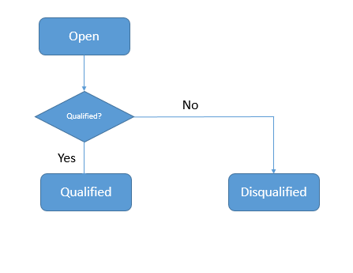
Leads
A lead represents any person or organization that a company might have the potential to do business with.
Lead Status

Slide 5
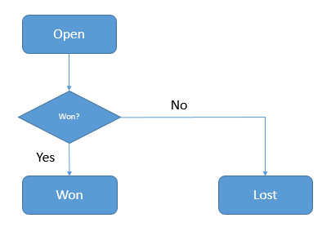
Opportunities
Opportunity represent for a potential sale for a specific customer
Opportunity Status

Slide 6
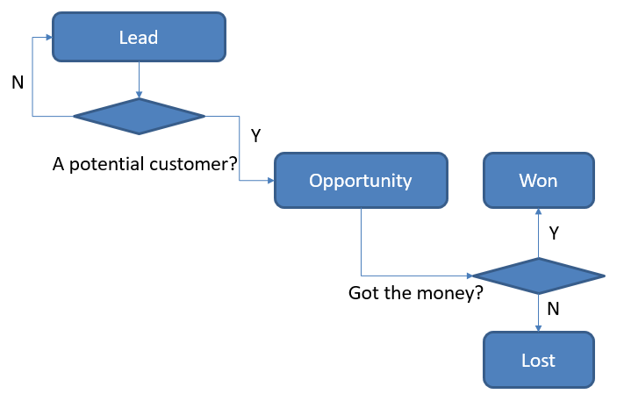
Sale Process

Slide 7
Demonstration
Create a lead
Qualify a lead
Won an opportunity
Track Email

Slide 8
Q&A!

Slide 9
Thanks for your attendance!

